Slide 2




Network Security – Network Segmentation
Performance
Security

Slide 3

Network Security – Network Segmentation
Performance
Large Network
Segment 1
Segment 2

Slide 4




Network Security – Network Segmentation
Security
Layr 2 - VLANs
10.0.1.0/24
10.0.0.0/24
VLAN 20
VLAN 10

Slide 5

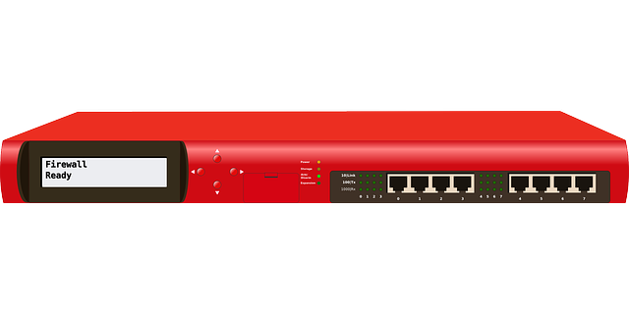
Network Security – DMZs
Public Network
(Internet)
Perimeter Network
Screened Subnet
(DMZ)
Private Network

Slide 6
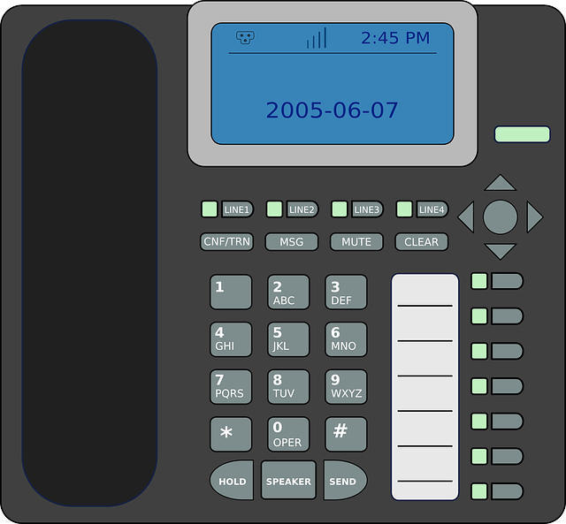
Network Security – VLANs
VLAN 10
VLAN 20
VLAN 30
VLAN 40
HTTPS
PBX
MySQL
VoIP Phones
Notes:
East-west traffic
North-south traffic

Slide 7
Network Security – Intranets
Public Network
(Internet)
LAN segment 1
Intranet
LAN segment 2
LAN Segment 2
HTTPS
MySQL

Slide 8
Network Security – Extranets
Public Network
(Internet)
VPN tunnels
Intranet 2
Company 1
Company 2
Intranet 1
Extranet

Slide 9

Network Security – Traffic Segmentation
Public Network
(Internet)
Zero Trust
North-south traffic
Firewalls, NIPS, DMZs
LAN
VLANS, Subnets, HIPS, ACLs
East-west traffic

